Slide 1
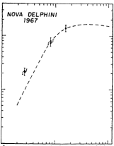
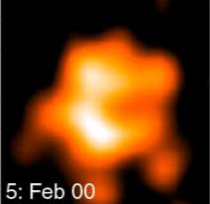
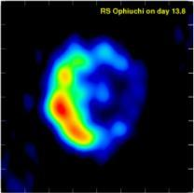
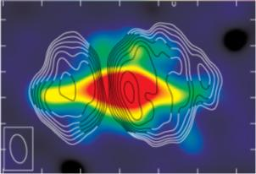
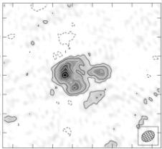
Binary orbits as the driver of Gamma-ray emission and mass ejection in classical novae -- VLBI detection of the internal shocks in nova V959 Mon
Jun Yang
Chalmers University of Technology, Onsala Space Observatory, Sweden
Collaborators: L. Chomiuk (US), J. D. Linford (US), T.J. O’Brien (UK), Z. Paragi (JIVE) , A.J. Mioduszewski (NRAO), R.J. Beswick (UK), C.C. Cheung (US), K. Mukai (US), T. Nelson (US), V.A.R.M. Ribeiro (RU Nijmegen), M.P. Rupen (NRAO), J.L. Sokoloski (US), J. Weston (US), Y. Zheng (US), M.F. Bode (UK), S. Eyres (UK), N. Roy (Germany), G.B. Taylor (US).

Slide 2
Nova
A nova is a cataclysmic thermal nuclear explosion on a white dwarf, which causes a sudden brightening of the star.
If the companion star overflows its Roche lobe, the white dwarf will accrete gas from the companion's outer atmosphere.

Slide 3
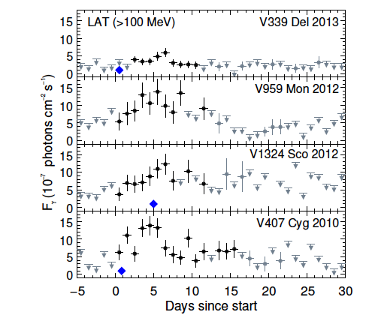
Classical Nova V959 Mon: 3rd Fermi Nova
V959 Mon
Peak: 2012 Jun 19 – Day 0
No early optical observations due to solar congunction.
# V959 Mon has a main-sequence companion, a low-density circumbinary environment, thus, no shock acceleration in an interaction with surrounding material.
# The orbital plane is edge-on (Page et al. 2012)
Fermi-LAT 1-day binned light curves of the four novae.
Reference: The Fermi-LAT Collaboration 2014, Sci., 345, 554

Slide 4
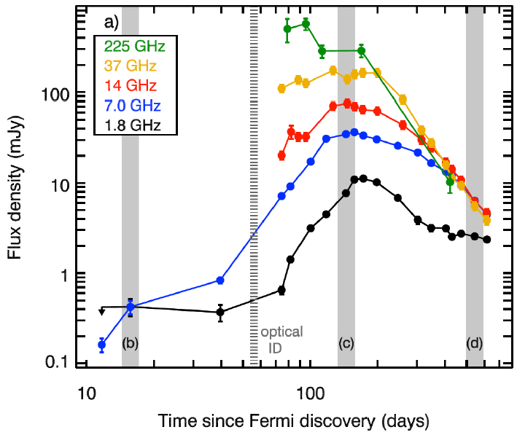
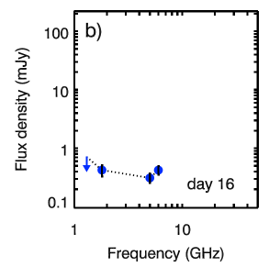
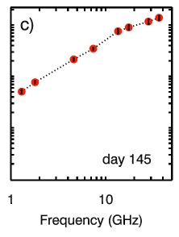
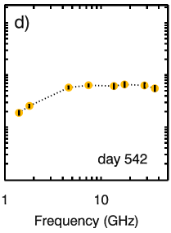
Radio light curves and spectra
Flat spectrum at low frequencies. Non-thermal emission?
JVLA multi-frequency radio light curves
(Chomiuk in Stella Novae: Past and Future Decades)
Assuming t=0 on June 22 2012

Slide 5
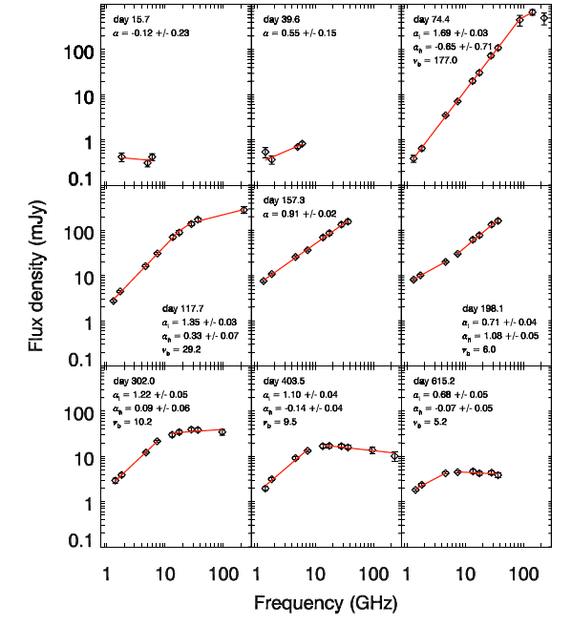

Slide 6
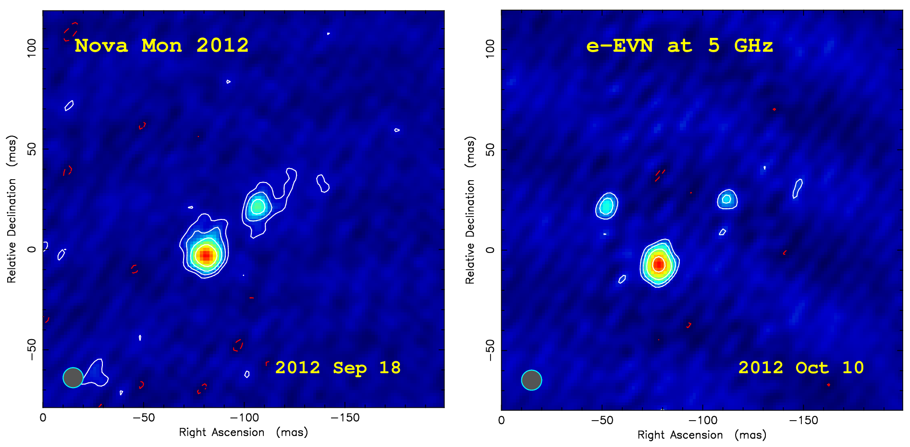
Evolution of radio morphology
35.5±0.2 mas
45.8±0.4 mas
Together with the VLBA imaging results, the average expansion speed of the pair of knot is 0.4 mas/day. Tb ~ 2 x 10^6 K
There is also a 3rd VLBI knot detected on 2012 Oct 10

Slide 7
e-MERLIN image
Colour
# e-MERLIN at 5.8 GHz
# Day 87
Contours
# e-EVN at 5 GHz
# Day 91
Only 19% radio flux density is restored in the e-EVN image.

Slide 8
VLBI knots vs VLA lobes
Evolution of VLA radio morphology: almost 90 deg flip
Left: 36.5 GHz VLA color image of the thermal ejecta on day 126. Contours are the VLBI-detected knots on day 113
Right: 36.5 GHz VLA images on day 615 (colour) and day 126 (contours).

Slide 9
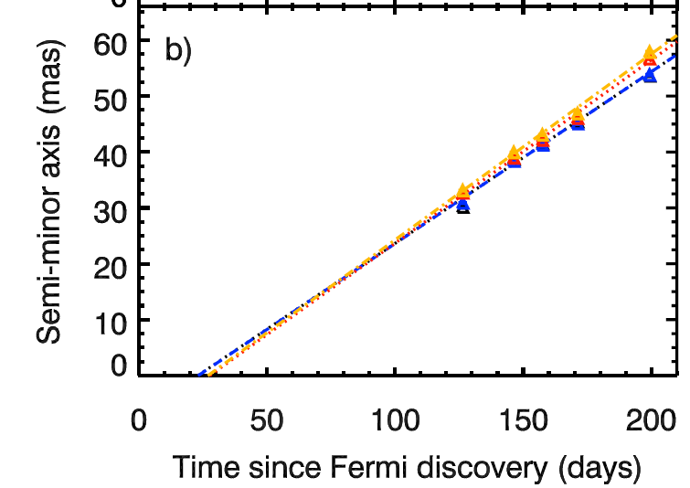
JVLA observations of expansion rate
13.5 GHz
0.64 mas/day along major axis (EW), 0.62 mas/day along minor axis (NS).
36.5 GHz
0.37 mas/day along major axis (EW), 0.66 mas/day along minor axis (NS).
EW Direction: Optically thin. NS Direction: Optically thick.

Slide 10
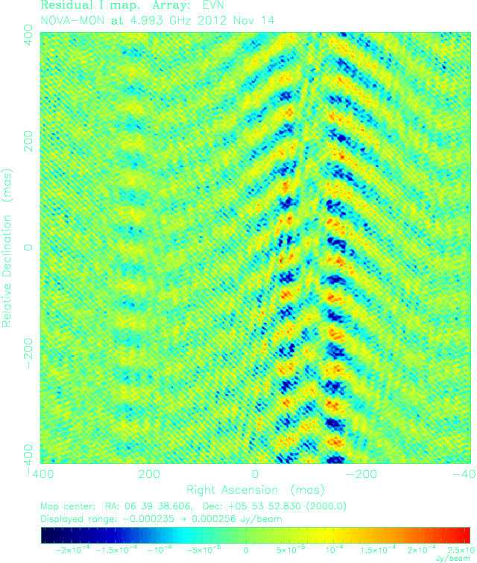
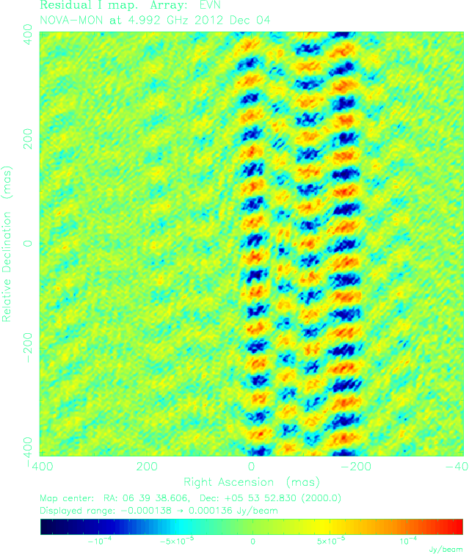
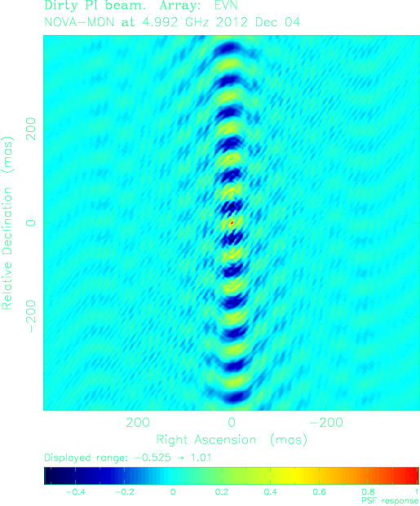
Fast expansion in EW direction
Dirty Map
Dirty Map
Dirty Beam
Nov 14
Dec 04
At least two extended thermal components can be identified in the dirty maps.
Their expansion rate: ~2 mas per day in EW direction.

Slide 11
Simple illustration of the 2012 outburst
The nova envelope (yellow ellipse) expands and interact with the binary system, yielding dense material in the equatorial plane.
The white dwarf powers a fast wind that is funneled towards the low-density poles (blue cones) . The differential velocity produces shocks (orange lines), observed at the surface of the optically thick ejecta.
Once the wind ceases, the polar outflow will detach from the binary and quickly drop in density. The slower-expanding equatorial material will remain dense for longer, and will dominate the radio images at late times.

Slide 12
Conclusions
The long-life tracer of the Gamma-ray emission, synchrotron emission, was revealed by the VLBI observations in nova V959 Mon.
Binary orbits drives mass ejection and Gamma-ray emission in classical novae.
Reference
Laura Chomiuk, Justin D. Linford, Jun Yang, T.J. O’ Brien, Zsolt Paragi et al. 2014, Nature, doi:10.1038

